Slide 1
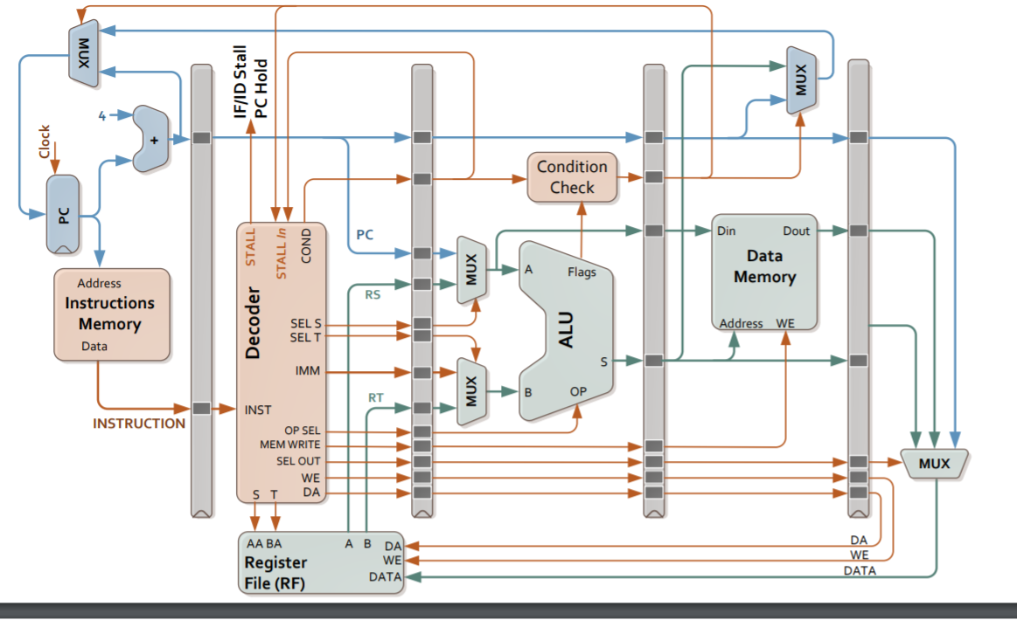
OR do BC
OR do BC
PC Value
PC+1
PC+1
PC+1
BC
BC\
PCLoadEnable
PCLoadEnable

